Slide 1
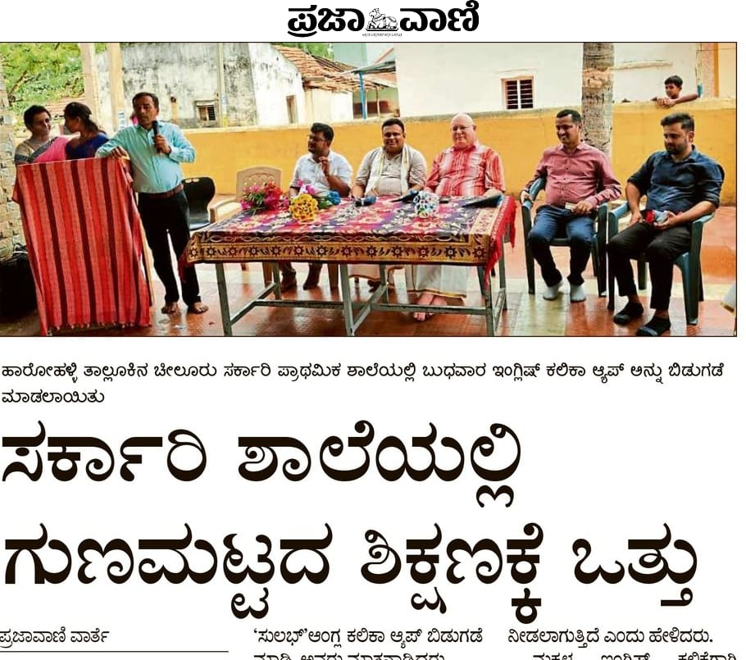
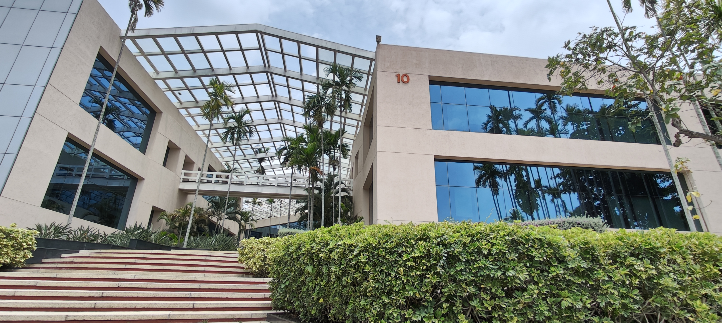
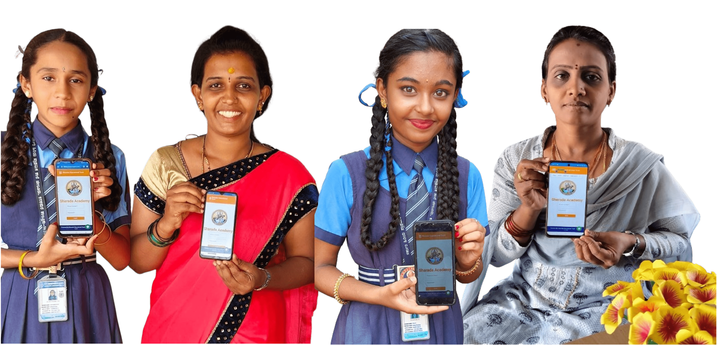
The Situation in India
India grew very rapidly in the last couple of decades. This growth brought wealth and opportunity with it, especially in the IT industry. Nowadays the children of the original “IT-Boomers” have grown up enjoying a good education and are given preference for the new IT jobs. The poorer and rural areas can no longer compete so have been left behind and are struggling to catch up.
On one hand there are people working in shiny office buildings with all the tech you could dream of. On the other hand, are schools that can not afford white boards. Once one visits the two worlds the difference is not just viable but can very much be felt.
Our Contribution
We set out to create a learning management system (LMS) to reach those left behind. The mobile app should support the teaching of spoken English and aid in automating and organizing the curriculum. We partnered with the Sharada Educational Trust to tailor the app to their needs and to overcome their specific challenges, including reaching rural community teachers and college girls.
We had to build the app with mobile first in mind since our end users do not have access to laptops, if lucky they own a not too old smart phone.
The girls and women in the picture above are the kind teachers and students that tested the app with us and will start using it in the next school year.
The future of Sulabh
The app was given the name “Sulabh” which means easy in a lot of languages in India. The name is an abbreviation that stands for “Sharada Universal Learning App for Bharat”.
We had the opportunity to soft launch the app in a rural government school in the town of Cheeluru. The event was even covered in the local newspaper. From now on forward Sharada Educational Trust will grow the userbase and bring education not just to Cheeluru but to the Karnataka area and maybe to wider parts of India.
LMS for Rural India
Graduate(s): | Tobias Erpen Alayne Hiltmann Lukas Vogel
Professor: | Kenneth Ritley
Expert: | Alain Joray
Bachelor Thesis 2024 Degree Programme Computer Science

